Slide 1
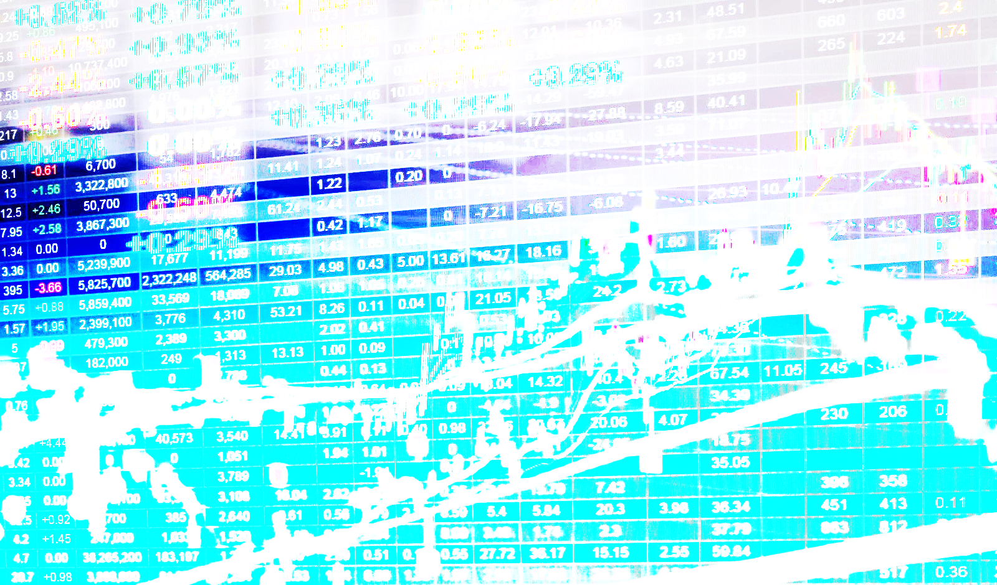

Slide 2
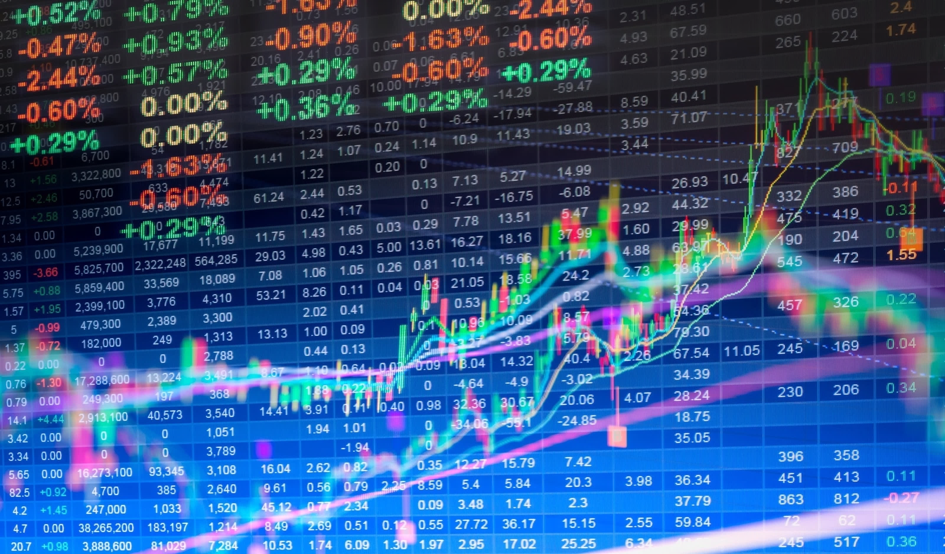
“I never use valuation to time the market. I use liquidity considerations and technical analysis…”
- Stan Druckenmiller

Slide 3
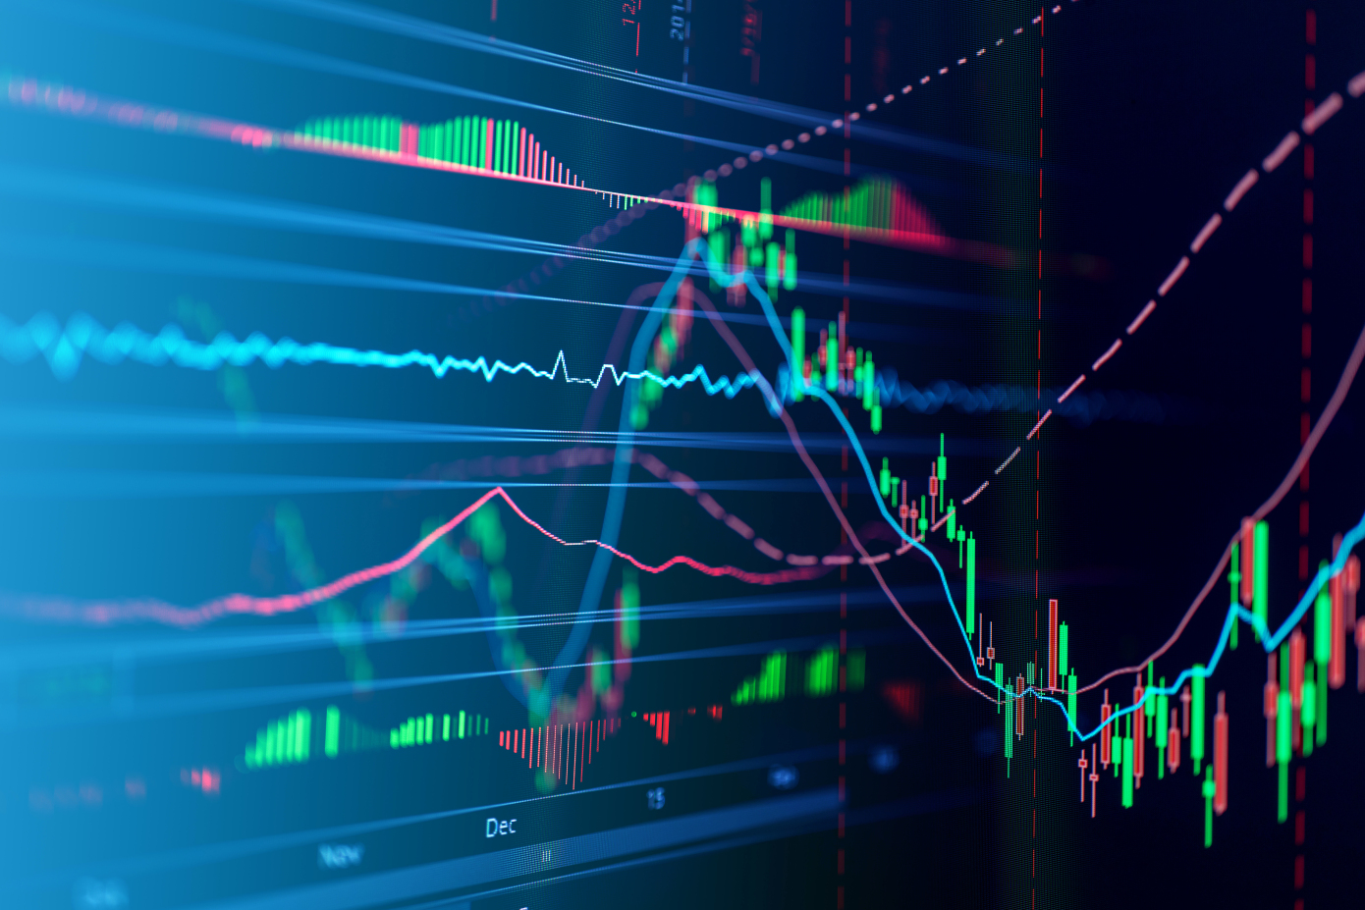
Spot trends with leading technical indicators BEFORE your next trade.

Slide 5
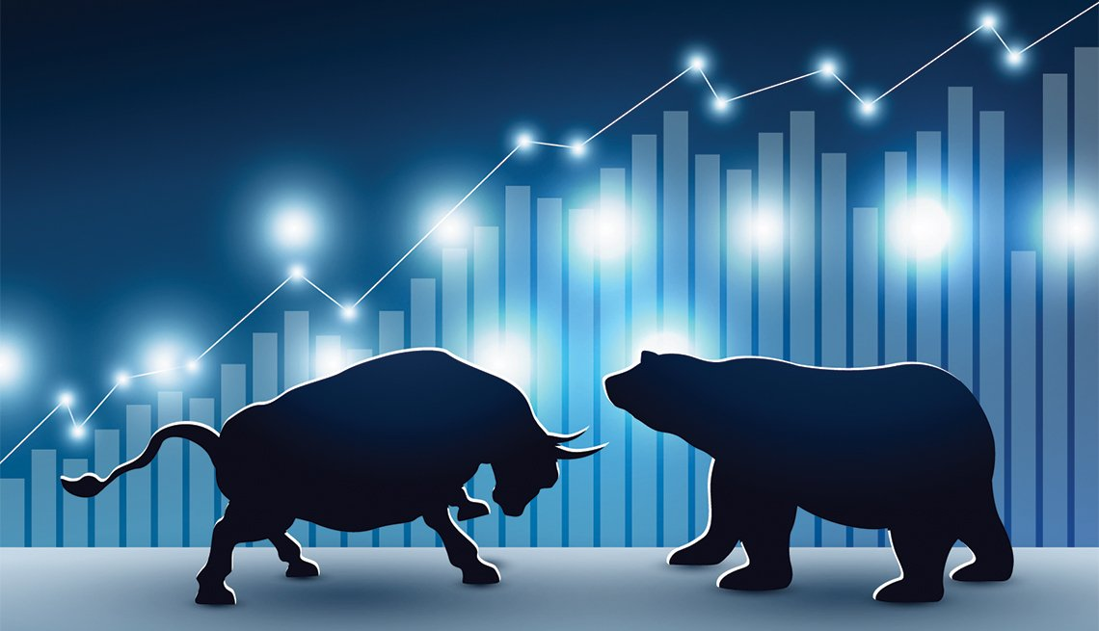
Share your due diligence and connect with other traders to find the next play

